Slide 1
BIKE RENTAL SYSTEM
Presentation on SQL Project Guided by: Ravi Teja Sir Presented by: KUNAL BHALERAO

Slide 2
Introduction Primary Goals Purpose and Importance Database Design Diagram Operations on Tables Business Queries Conclusion
AGENDA

Slide 3

Introduction
The Bike Rental System is a platform designed to simplify the process of renting bikes for short or long durations. It aims to provide a seamless experience for customers and efficient management for administrators. The system manages users, bike inventory, bookings, and returns in a structured and reliable way.

Slide 4





Purpose & importance
The purpose of the Bike Rental System is to create a digital solution that:
Provides easy access to bike rentals for customers.
Manages bike inventory, availability, and condition.
Keeps track of customer details, rental duration, and payment.
Enhances mobility for users and promotes eco-friendly travel.
Automates the rental process and reduces manual errors.

Slide 5
PRIMARY GOALS
To provide quick and affordable bike rentals to customers.
Maintain real-time availability of bikes.
Enable smooth customer registration, booking, and return process.
Record and track user history, bike maintenance, and payments.
Ensure secure and scalable management for admins.

Slide 6

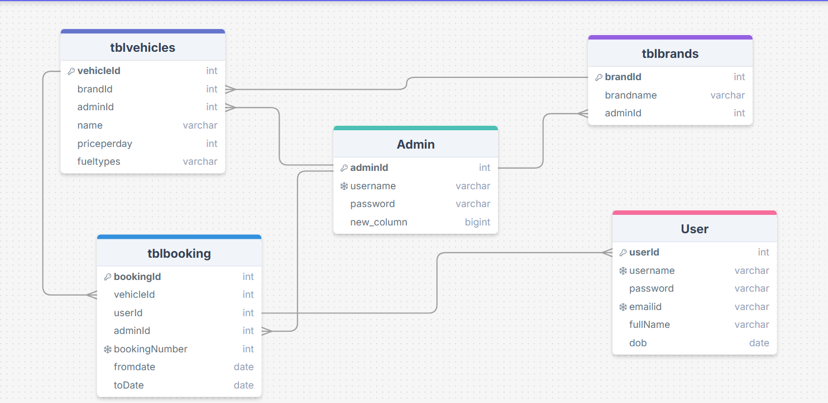

Slide 7
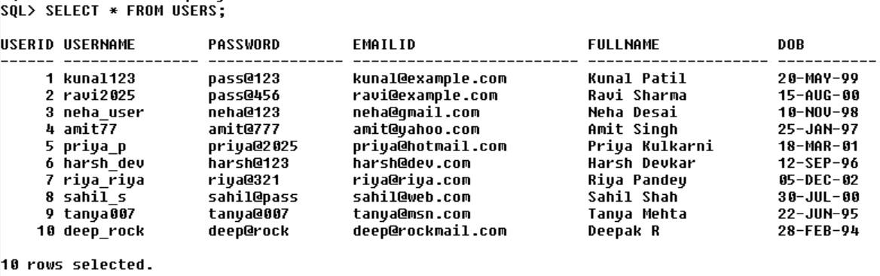
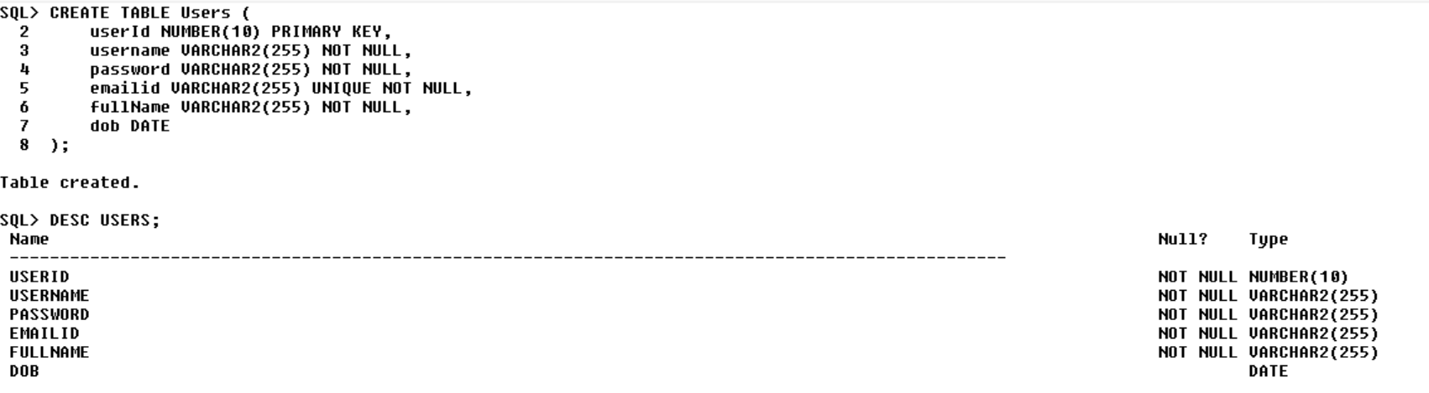
USER

Slide 8
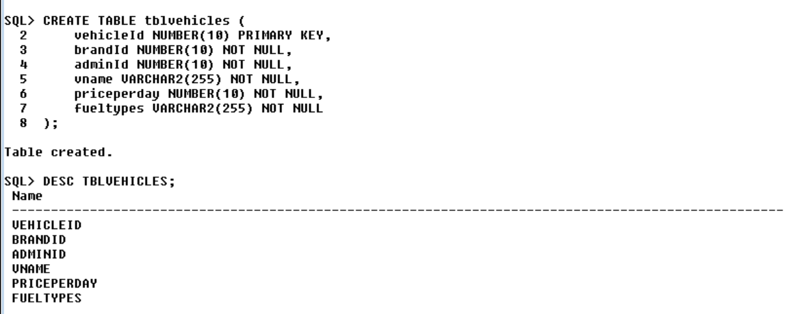
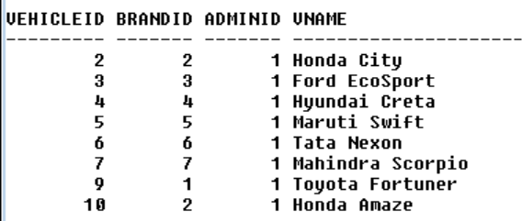
Vehicle table

Slide 9
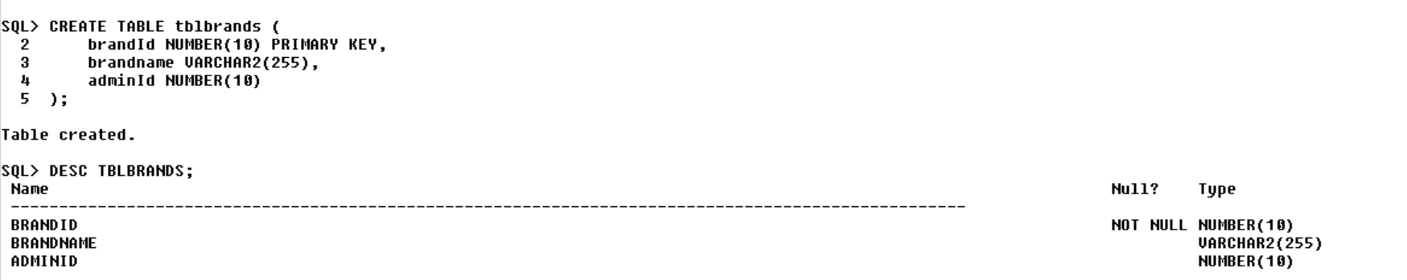
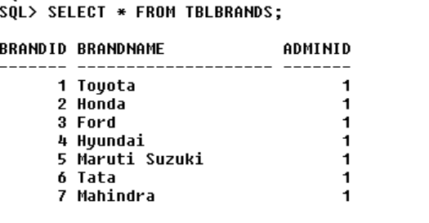
Brands Table

Slide 10
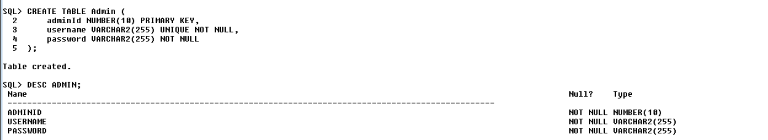
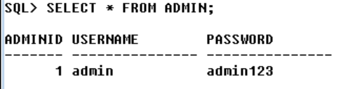
ADMIN

Slide 11
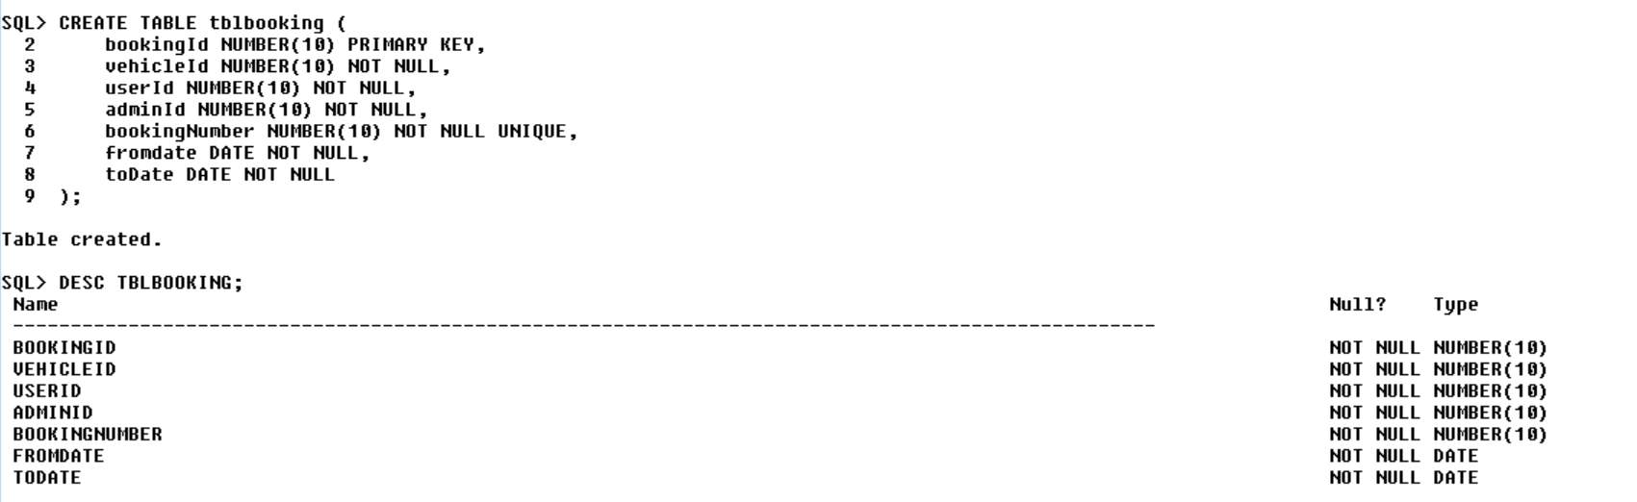
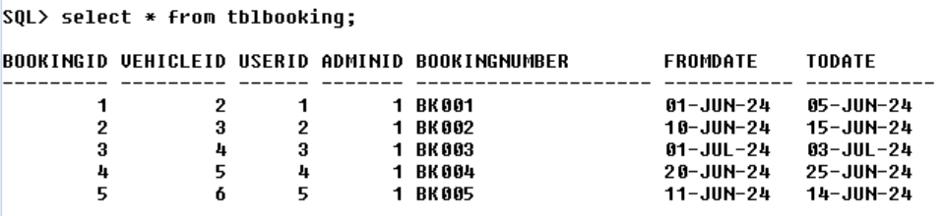
Booking table

Slide 12
Operations on Tables
Examples:
Insert new user or admin records.
Update bike status after rental or return.
Track bookings and rental duration.
Delete inactive users or outdated records.
Query for available bikes by brand or type.

Slide 13
Business Queries

Slide 14
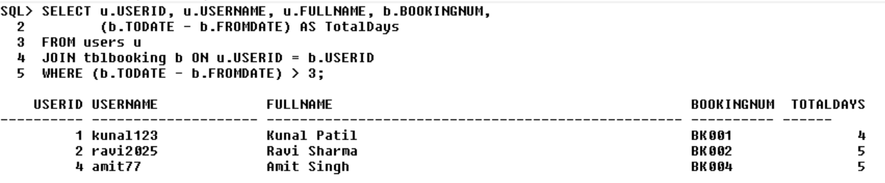
List users who booked vehicles for more than 3 days

Slide 15
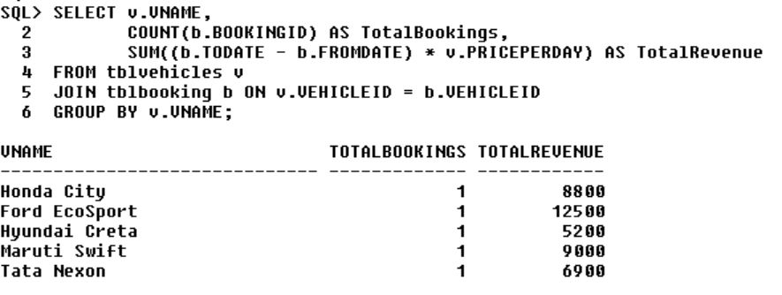
Find total revenue generated by each vehicle

Slide 16
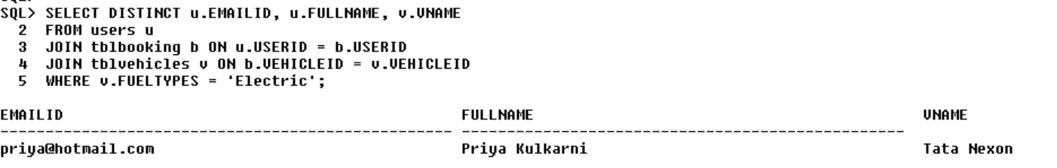
Show user email IDs who booked Electric vehicles

Slide 17

Achievements
Successfully developed and implemented a Bike Rental System.
Enabled real-time tracking of rentals and inventory.
Simplified user interaction with a clean and responsive UI.

Slide 18
Future Improvements
Add online payment and invoice generation.
Enable mobile app integration for on-the-go bookings.
Improve reporting features for admin and analytics.
Add location-based tracking and GPS for bikes.

Slide 19

THANK YOU FOR YOUR ATTENTION Any questions?

